Slide 1

AI – Based Network Intrusion Detection System
[Ravikiran Pendyala]
[AICTE ID:STU68277cc3548ec1747418307]
Internship ID: INTERNSHIP_1762343729690b3b31bb89f

Slide 2

PROBLEM STATEMENT
In present world computer networks facing a large number of cyber attacks. Traditional security machine like firewalls and rule-based intrusion systems are not sufficient to detect attacks. Therefore, there is need for an intelligent systems that can automatic for network traffic and detect intrusions using AI and Machine Learning techniques.

Slide 3
Project Description My project implements an AI-Based Intrusion Detection System(NIDS) that uses ML to identify malicious network activities. The system analyses network traffic data and classifies it as normal or intrusive. The project use the CIC-IDS-2017 real world data , contains labelled network traffic data including normal traffic and different attack types. Streamlit-based dashboard is developed to train and test live traffic values.

Slide 4

WHO ARE THE END USERS?
Network Administrators
Cyber Security Analysts
Organizations managing networks
Educational institutions for learning cyber security concepts

Slide 5

Technology Used
Programming Language: Python
Machine Learning Algorithm: Random Forest Classifier
Dataset: CIC-IDS-2017 (Canadian Institute for Cybersecurity)
Libraries:
Pandas – Data handling
NumPy – Numerical operations
Scikit-Learn – Machine learning
Streamlit – Web dashboard
Development Tool: Visual Studio Code

Slide 6
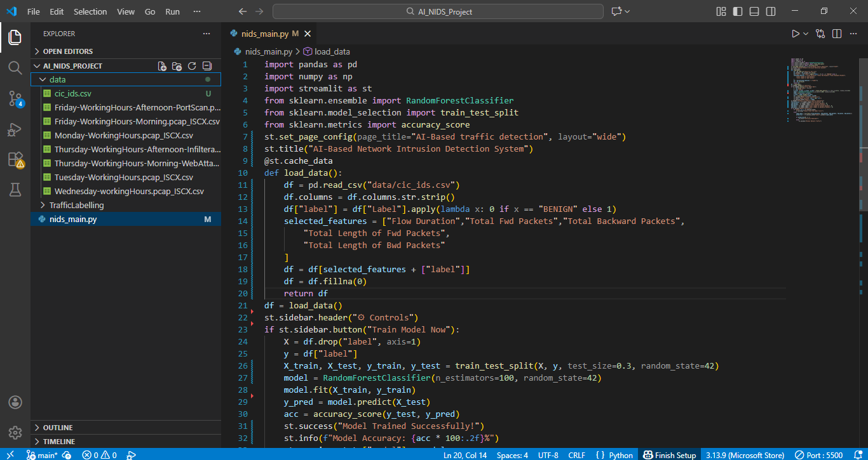
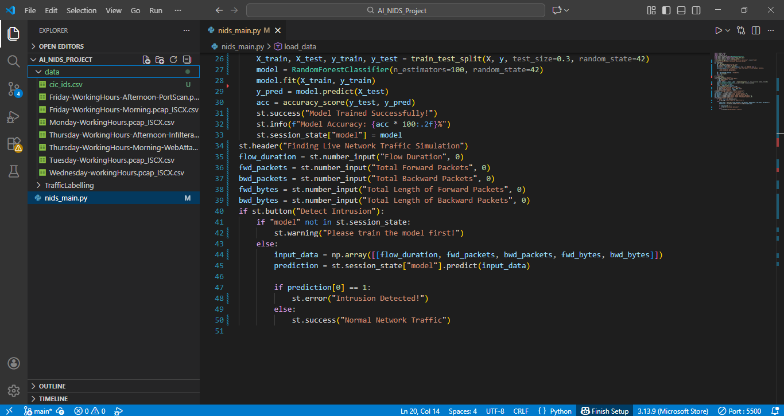
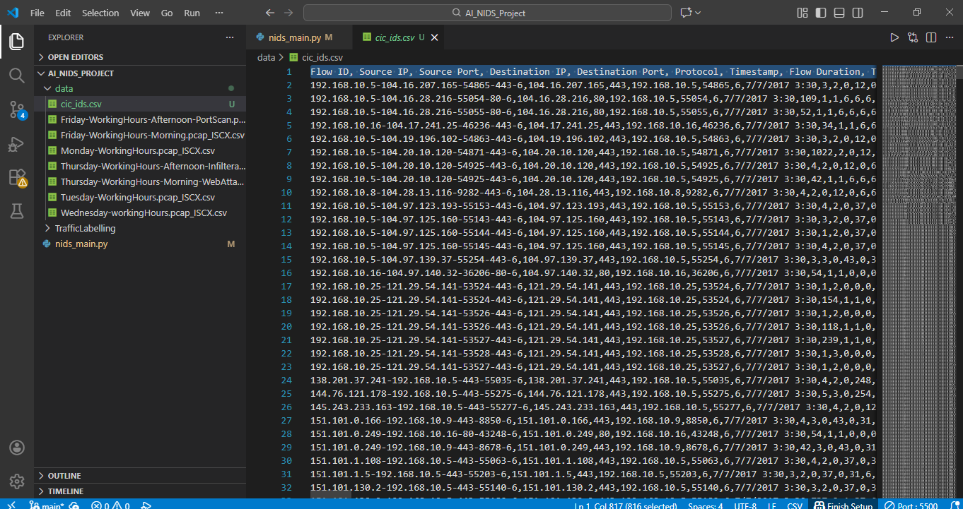
RESULTS
Code-part 1
Code-part 2
Demo Link
Dataset Image

Slide 7
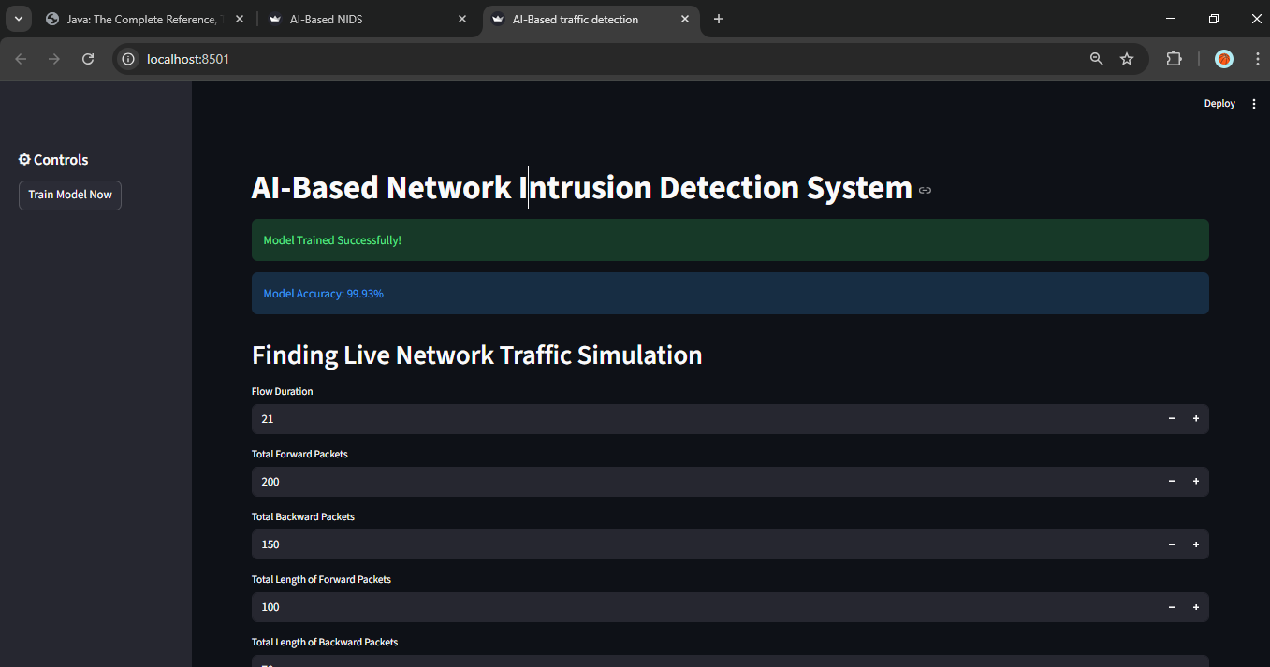
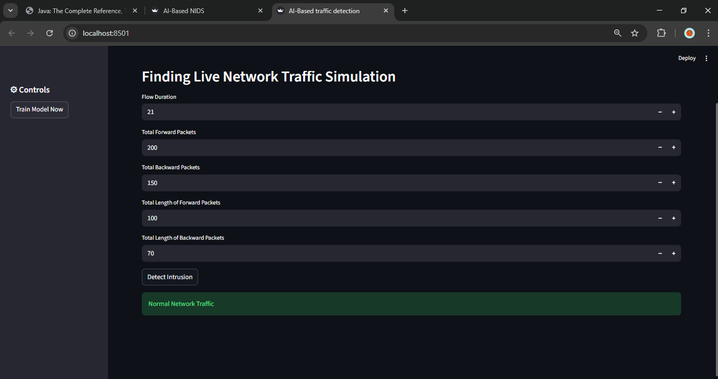
RESULTS
Training the AI model (by assigning values)
Model detected as Normal Traffic flow
Demo Link

Slide 8

Certificate - Protection from browser attacks

Slide 9

Certificate - Introduction to System Security

Slide 10

Certificate - Securing Android Devices

Slide 11
GitHub link

Slide 12
Thank you
.
.

